Slide 1
The data runway: Soaring to New Heights with Fabric Data Activator
Denis Selimovic

Slide 2
Agenda
Introduction
What is Data Activator
How to add Live Data
How can I use it and how will it continue
Q & A

Slide 3
Introduction

Slide 4




Introduction
Denis Selimovic
Principal Consultant @ b.telligent in Switzerland
Power BI User since the release 2015
Co-Organizor of Fabric User Group Switzerland
Power BI Super User
Blog:
wtf.bi/linkedin

Slide 5
What is Data Activator?

Slide 6

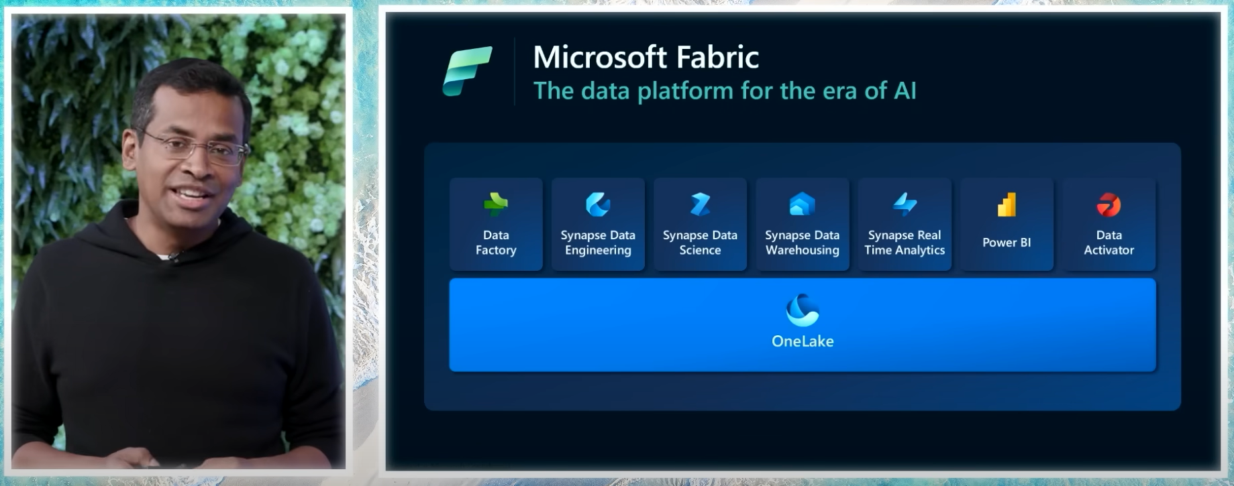
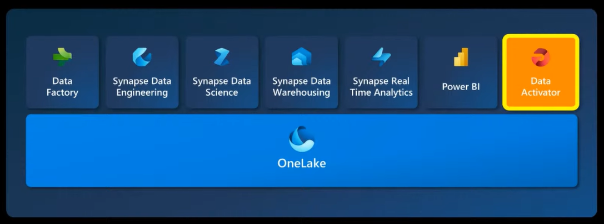


Slide 7
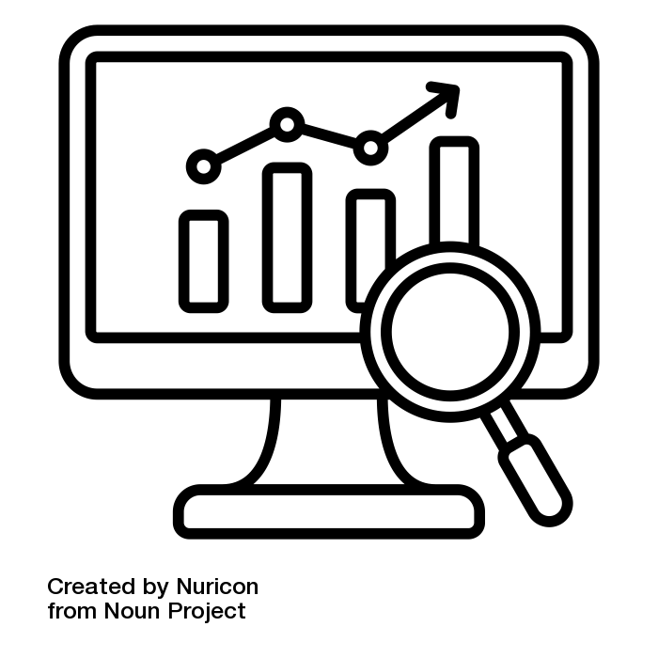







What is Data Activator?
No-Code solution, to start actions, based on data and criteria
Update Passenger when gate changes
Make sure temperature in cooling vehicle stays as required
Real-Time-Data only for IT-Pros, no Self-service
Monitors Artifacts in Fabric
Detect in real time if a specific criteria is met
Starts actions based on these criteria

Slide 8
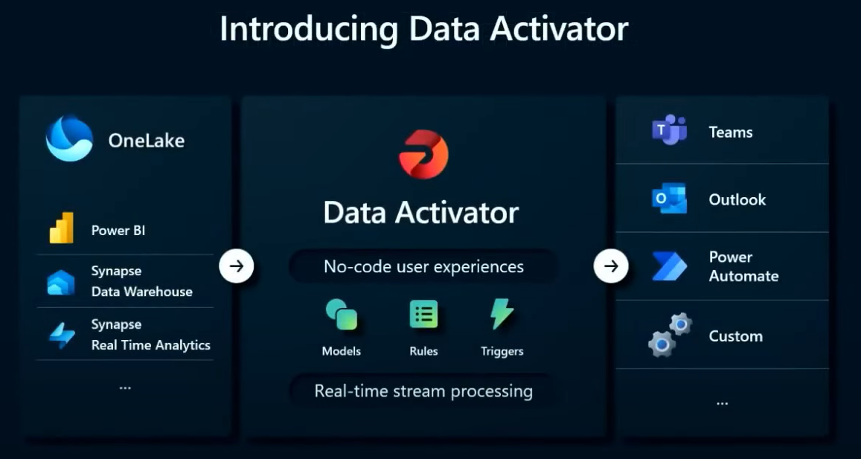
What is Data Activator?

Slide 9
What is Data Activator?
Demo Data Activator

Slide 10
What is Data Activator?

Slide 11

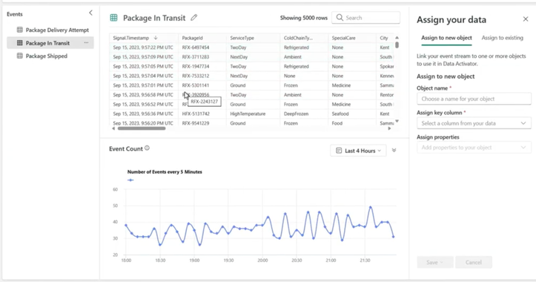
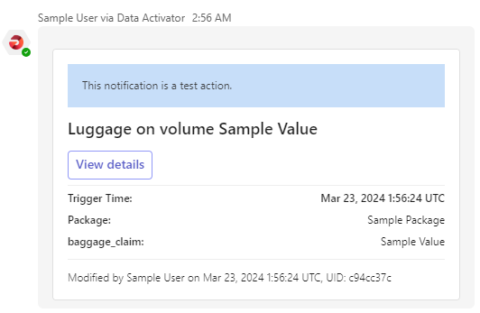
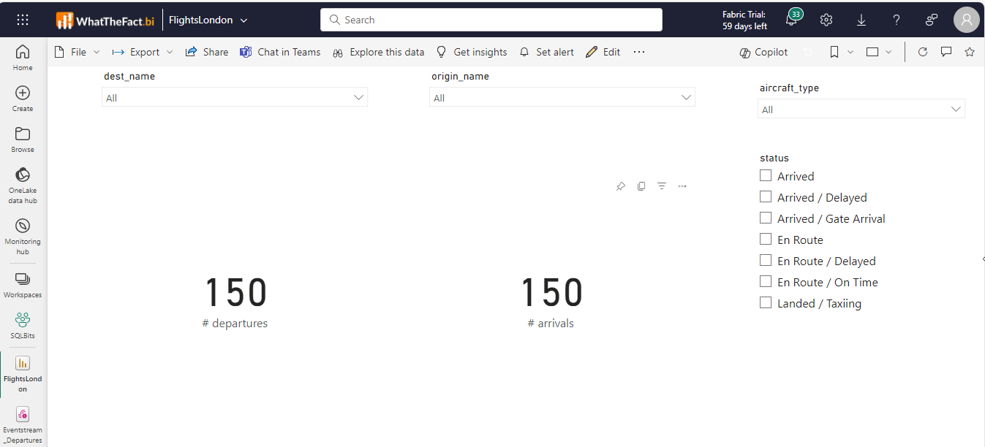
What is Data Activator?
Monitor
Detect
Act
Power BI

Slide 12
How to add live data?

Slide 13


How to add live data?
Synapse Data Warehouse
Synapse Real Time Analytics

Slide 14
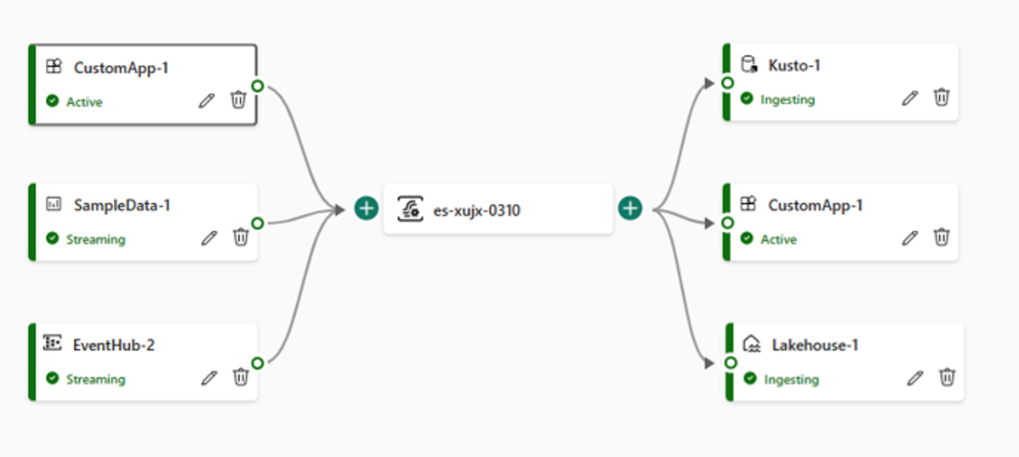

What is Data Activator?
Monitor
Check
Start
Fabric event stream
Synapse Real Time Analytics

Slide 15
What is Data Activator?
Demo Event Stream

Slide 16
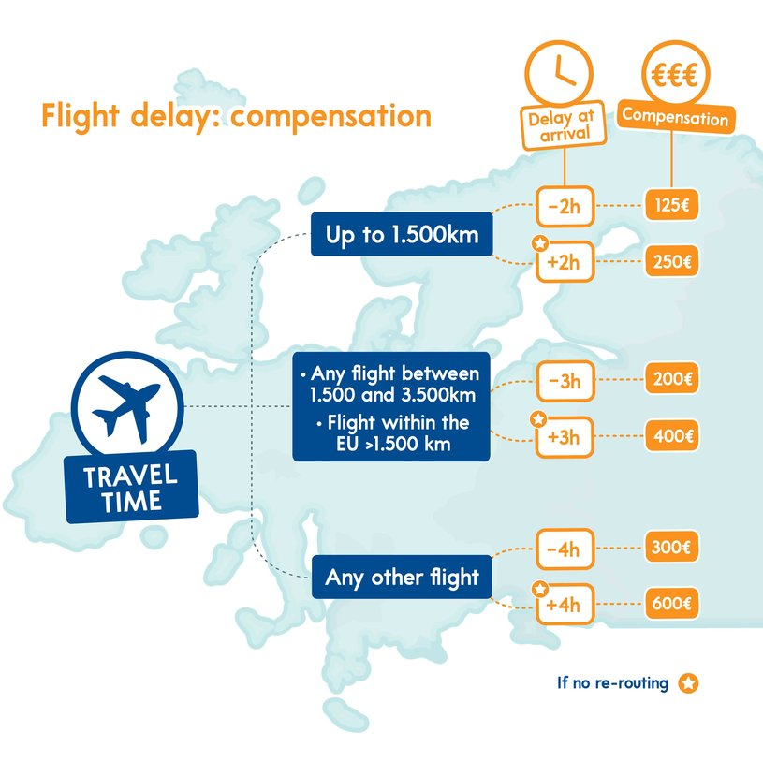
What questions could we solve?

Slide 17
How can I use it and how will it continue

Slide 18
How can I use it and how will it continue
Everything that has a time related update
Shipping status
Delay
Things that have to or cannot pass limits
Temperature in a truck
Available parking spots
Fill level of a trash bin
Currently still a little buggy, but in Preview
Bigger challenge: streaming data
Workaround: Power BI Report!

Slide 19
What is Data Activator?
Demo Power BI Report

Slide 20
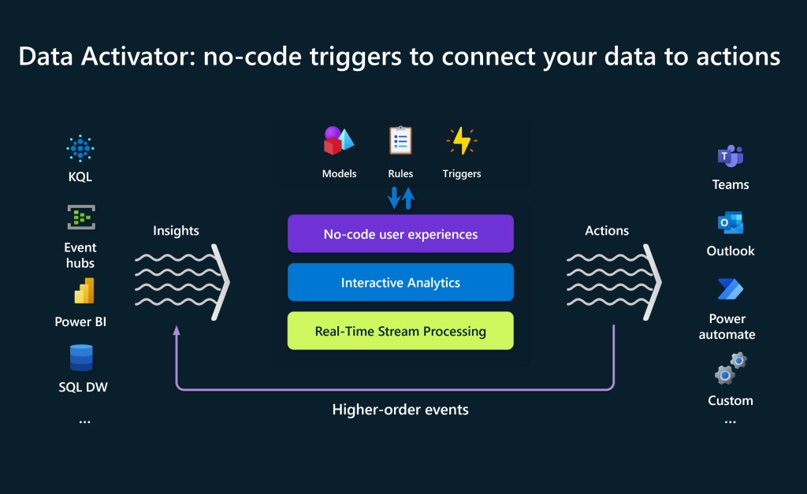
How can I use it and how will it continue

Slide 21

Feeback
Short-URL:
https://sqlb.it/?12643

Slide 22














